Slide 1

Slide 1
"Modeling Recruitment Expenses in U.S. Post-Secondary Institutions"
"Kiersten Hamby, Breanna Ranglall, Krutika Tekwani"

Slide 2
Slide 2
About the Dataset
The Dataset presents statistics on expenses incurred by an institution that are attributable to recruiting of student athletes.
It Includes information regarding athletic participation, athletic student aid, staffing, revenues, and expenses, by men's, women's, and coed varsity teams. It was collected by the U.S. Department of Education Office of Postsecondary Education.
The survey results are intended to help make prospective students aware of a school's commitment to providing equitable athletic opportunities for male and female students.
https://ope.ed.gov/athletics/#/datafile/list
2

Slide 3
Slide 2
The Data
Research Question
What Variables Best Predict Total Athletics Recruiting Expenses for Post-Secondary Educational Institutions?
2

Slide 4
Slide 2
Variables Used
Institution Name
State
Classification
Total Student Count
Sector Name
Total Student Aid
Head Coach Salary Men
Head Coach Salary Women
Number of Head Coaches Men
Number of Head Coaches Women
2

Slide 5
Slide 2
Hypothesis
Null Hypothesis – None of the variables have a significant impact on the total recruitment expense.
Alternate Hypothesis- We assumed that the increase in salary for the head coaches will result in an increase in the total recruitment expense.
2

Slide 6
Creating the Model
Multiple Regression Model
What factors best predict recruitment expenses of different U.S. post-secondary educational institutions?
Variables
Chose mostly quantitative variables but left some identification variables of the schools
Omitted schools that had missing variables or values of 0

Slide 7
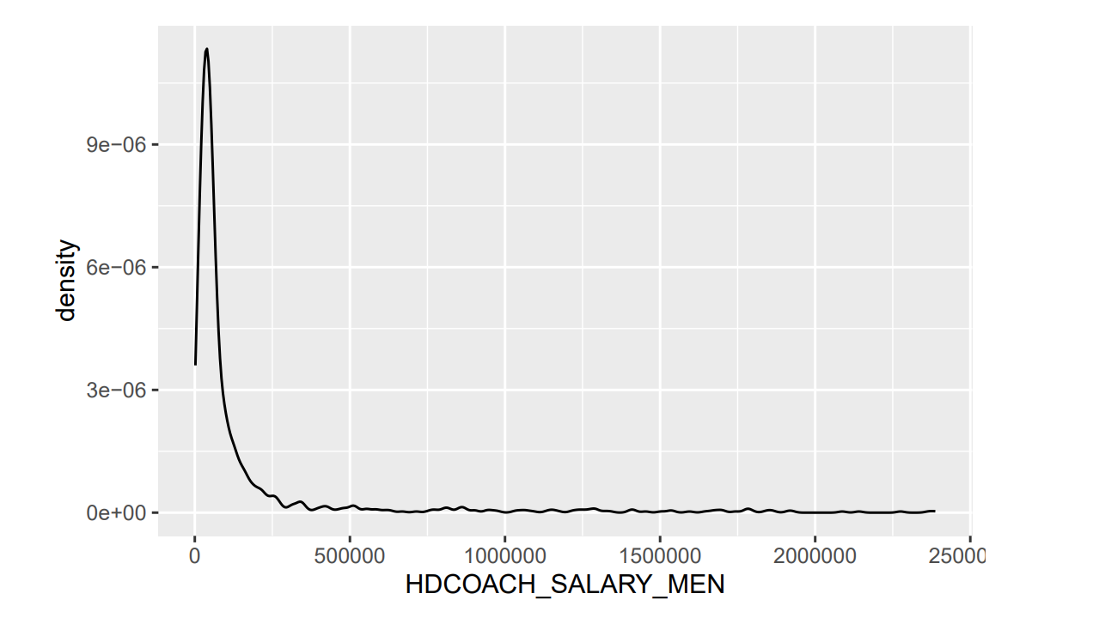
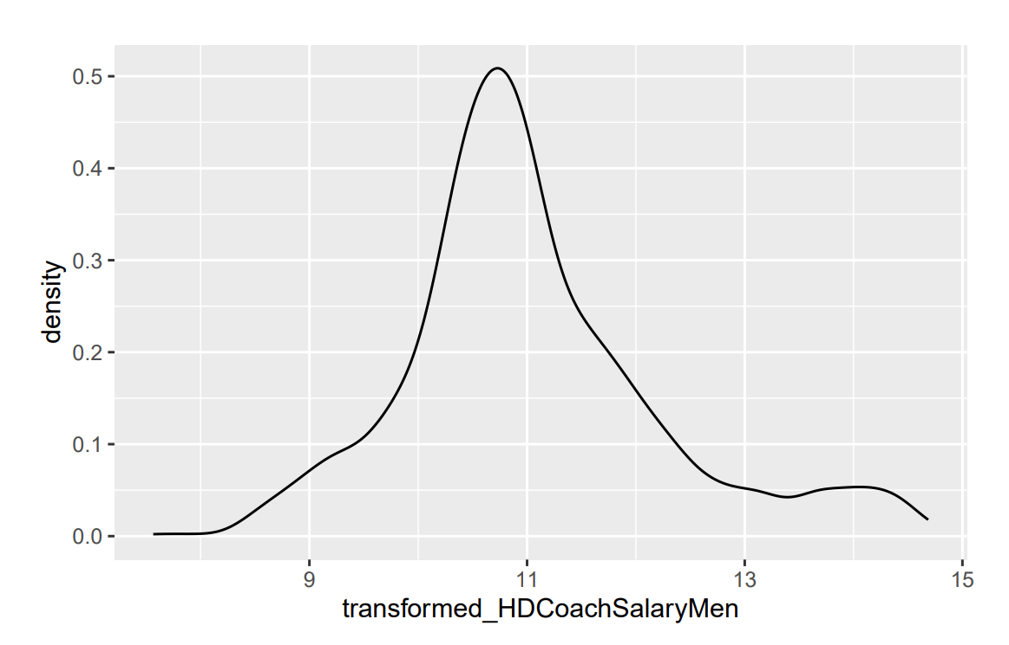
Transformations
Did not meet Normality or Equality of Variance Test
Forward selection, backward selection, stepwise - none helped
Skewed variables
Log transformation of monetary explanatory variables
More normal
Normality and equality of variance greatly improved

Slide 8
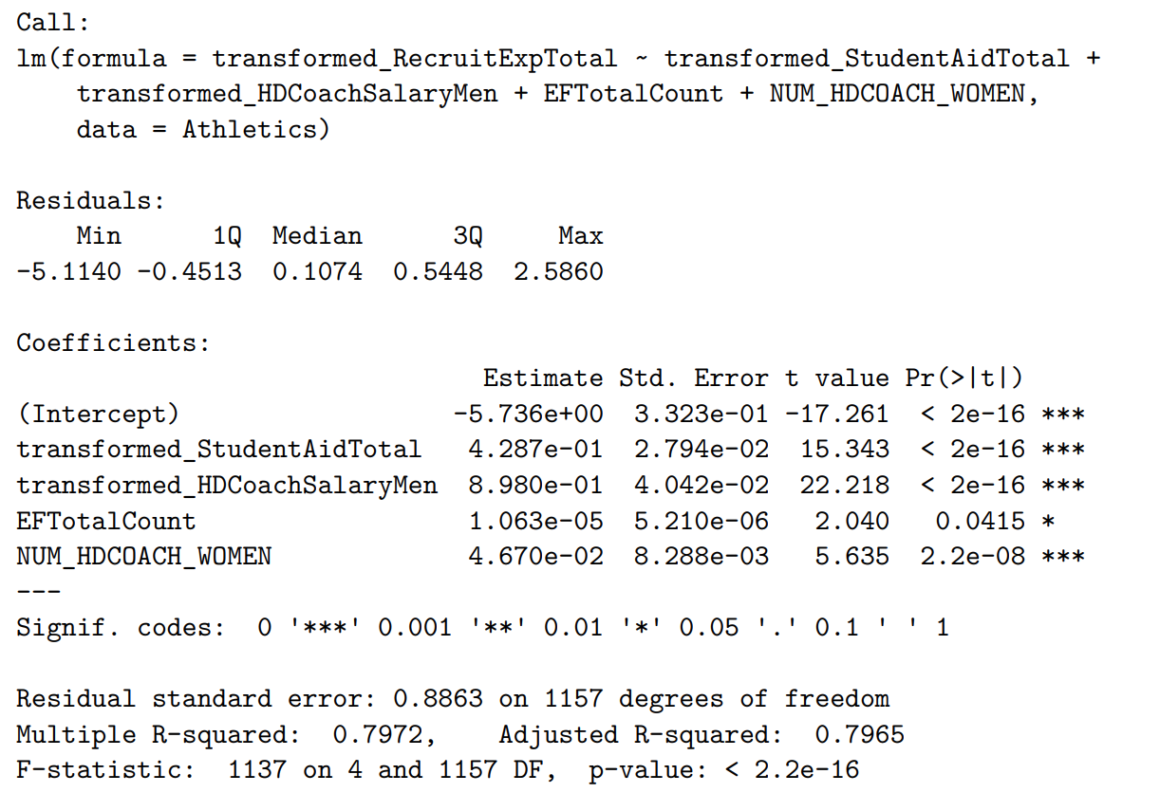
Final Variables
Forward selection, backward selection, stepwise
All gave us the same model
Example coefficient interpretation
For a 1% increase in Total Student Aid, holding all other variables constant, we expect Total Recruiting Expenses to increase by 42.87%.
For a 1-person increase in Number of Women Head Coaches, holding all other variables constant, we expect Total Recruiting Expenses to increase by 4.67%.

Slide 9
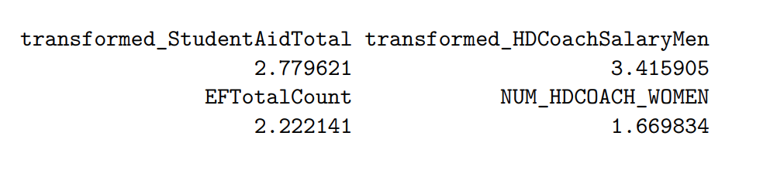
Multicollinearity
None over 5

Slide 10
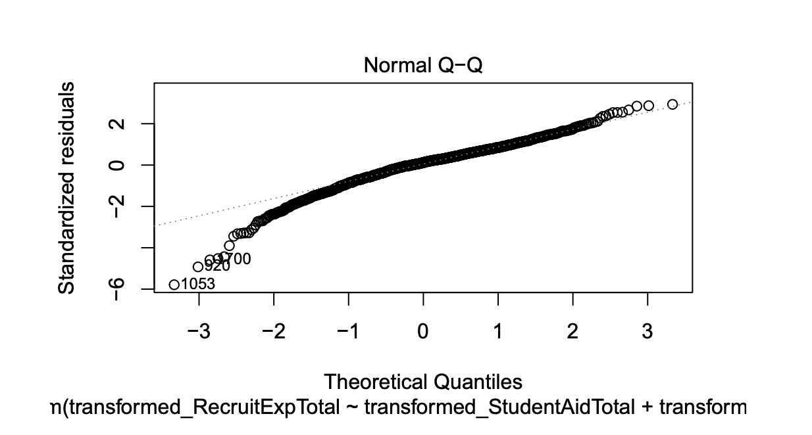
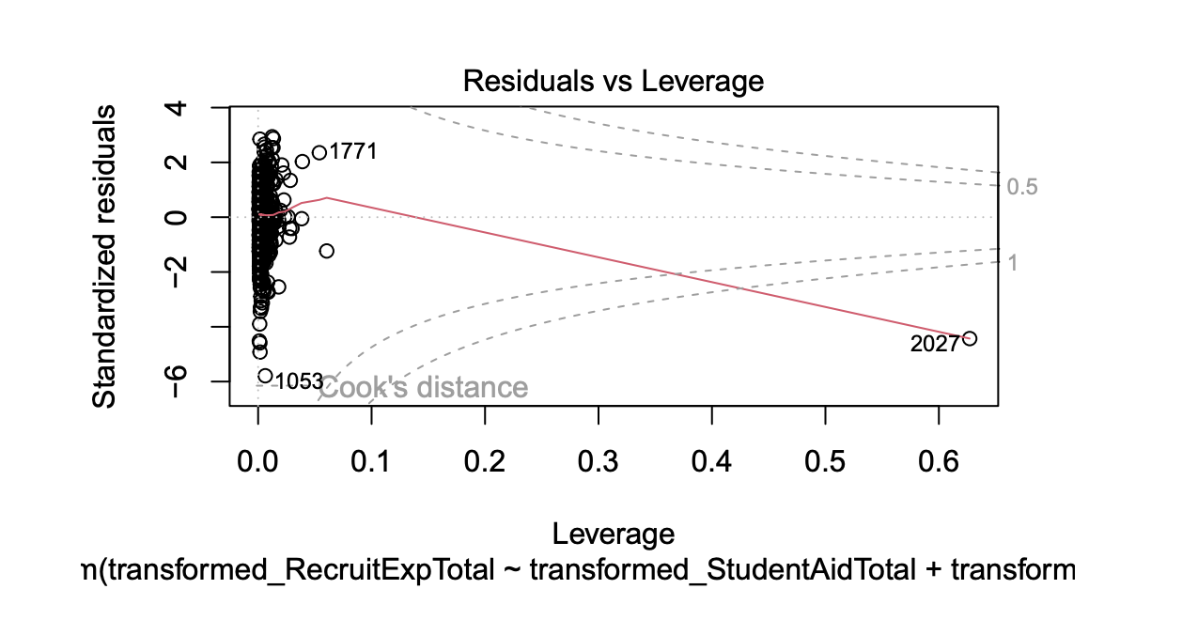
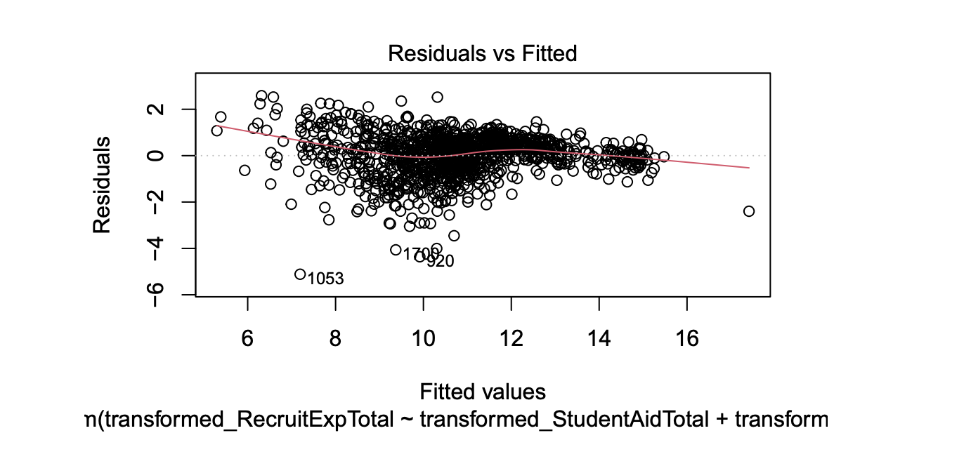
Visuals

Slide 11
Limitations
We had to remove schools that did not respond to certain questions or included 0's in responses so we would be able to transform variables
Independence condition was not satisfied because we weren't able to filter out schools that are associated with one another.
Must be mindful for drawing conclusions and using this model for prediction

Slide 12
Conclusion
The model explains 79.72% of the variability in total recruiting expenses.
We rejected the null hypothesis that there was no relationship between total recruiting expenses and the explanatory variables.
Next Steps
Gather sufficient data from all schools so broader conclusions can be drawn and the model can make more meaningful predictions
Look more into difference with data associated with gender as we hypothesize that male vs female recruiting expenses will be very different.

Slide 13
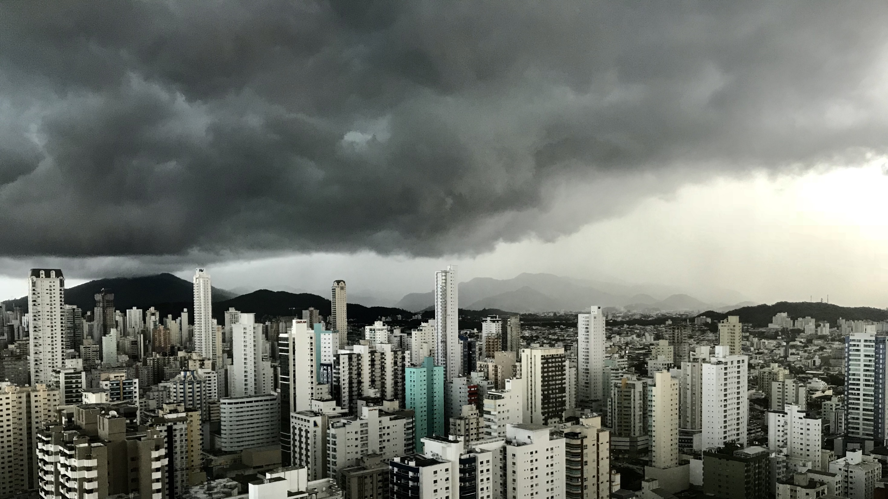
Slide 11
THANK YOU

